Slide 1






Intelligent Modernisation Assistance for Legacy Software
M18 Progress Meeting
August 22nd, 2019 10:00
Notes:
[Presenter: Vadim ; 30 sec max]
Quick introduction of the project title, of all partners, and of all people present:
UCL Kim Mens & Siegfried Nijssen accompanied by Xavier Lampe
RL Vadim Zaytsev accompanied by Alex Huart
VUB Coen De Roover accompanied by Philippe Westbroek

Slide 2
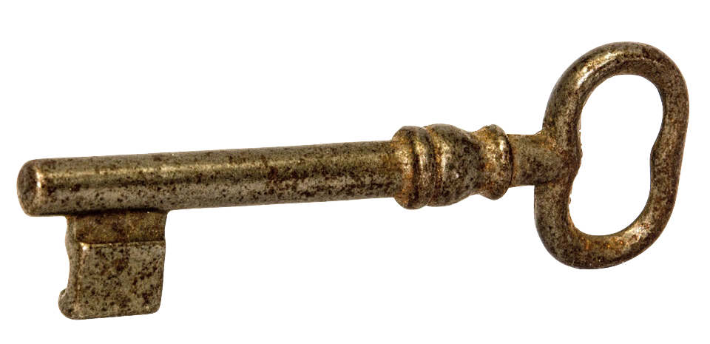
goal
Towards an intelligent modernisation assistant for legacy software
Key idea
Automating migration requires pattern discovery
Mining ≠ kinds of patterns in 3 use cases for 3 objectives
use case 1
use case 2
use case 3
Objective A
Objective B
Objective C
Notes:
[Presenter: Kim ; 30 sec]
Since pattern mining is a vast area, we limit the scope of our study to
three use cases corresponding to the kinds of information we are looking for in legacy code
and three objectives corresponding to what we want to achieve with the discovered information.

Slide 3

Ambition
use case 1
Coding idioms and programming conventions
use case 2
Library usage protocols and violations
use case 3
Systematic edits or repetitive changes
Objective A
Program comprehension
Undiscovered syntactic patterns
Replace by macros or language built-ins
API, library, framework usage patterns
Refactor based on understanding
Locations frequently subject to past edits
Refactor to avoid future changes there
Objective B
Anomaly detection
Code deviating from expected patterns
Rewrite to adhere to expected pattern
Violations of API and library usage patterns
Correct violations to fix faulty code
Locations similar to but not included in past systematic edits
Reapply systematic edits to these locations
Objective C
Modernisation assistance
Propose actions to im- prove respect of idioms
Suggest to complete or transform code
API, library, framework usage
Suggest correct use of API according protocol
Frequently executed past edits
Suggest complete edit based on partial edit
Notes:
[Presenter: Kim ; 1 min]
This matrix summarizes each of the previous use cases and links them to the three objectives we just identified.
We refer to the project proposal for a similar matrix that explains in which year and in what work package tasks each of these cells will be studied.
What we want to emphasize here on this slide is that our ambition in the project is to address each of the objectives (i.e. program understanding, detection of anomalies and recommendations for modernisation actions) from the perspective of each of the use cases.
Let’s just zoom into one (UC1 - Obj.A) :
Use case 1 is about discovering syntactic coding idioms and conventions in the code of a legacy systems.
Locations where undiscovered syntactic patterns occur can provide interesting information to Raincode’s engineers to better understand what is going on in the legacy system.
Once these patterns have been uncovered and understood they could then be used to replace the more complex syntactic patterns by simpler to understand and maintain higher-level code constructs, to enhance code reliability, understandability and maintainability.
Vadim will now illustrate this with a real motivating example.

Slide 4



APPROACH
WP3
WP2
previously unknown
software patterns
Pattern mining algorithms
Modernisation
Assistant
browser for patterns and instances
on-demand partial pattern matching
pro-active recommendations
WP1
DATA + metamodel
Evaluation
Importers
WP0
open-source software (academic)
legacy software (industrial)
Notes:
[Presenter: Coen ; 1 min 30 sec]
So, how will we realise our modernisation support? We have 3 technical work packages.
The first one is dedicated to developing a data representation for a system’s source code so that this source code can be given as input to a pattern mining algorithm. Based on our experience, this representation is likely to be graph-based in nature. What’s new is that it needs to be language-parametric in order to support multiple programming languages.
The second one is dedicated to the actual pattern mining algorithms. It is their job to uncover previously unknown patterns in the graph-based representation of the source code. We will start from a generic frequent subgraph mining algorithm, and incrementally adapt it to the specifics of the coding idioms in Y1, the usage patterns in Y2, and the edit patterns in Y3. Key will be an appropriate definition of support and relevance for each pattern type, to ensure that the uncovered patterns are useful and non-redundant.
The third work package is dedicated to the actual support that we can offer to the modernisation engineer based on the output of the mining algorithms. Here too, we will work incrementally. We will start from a simple browser for inspecting the uncovered patterns and their instances in the source code. This browser offers the engineer program comprehension support. Next, we will focus on pattern matching algorithms capable of detecting close, but incomplete matches for a mined pattern in the source code. These form the basis for our anomaly detection support. Finally, we will investigate how to offer this support pro-actively rather than in an on-demand manner. This entails launching the matching algorithms continuously in the background, and against a window of past and ongoing edits of the engineer, so that we can recommend completions for the engineer’s edits.
Transversal to these WPs is WP0, dedicated to the continuous evaluation of our technology ---which will be both in-vitro and in-vivo. In-vitro by the academic partners on small, open-source systems in contemporary languages. And in-vivo by the industrial partner on real legacy software systems from its clients.

Slide 5
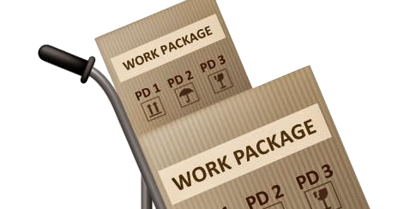

WOrk packages
WP0
Evaluation of developed system on
legacy systems (RL)
WP0
WP1
WP1
Data and meta-model for software repositories
and software patterns (VUB, UCL, RL)
WP2
WP3
WP2
Pattern mining algorithms
(UCL, VUB)
WP3
Pro-active modernisation assistant
(VUB, UCL, RL)
Project coordinator (VUB)
Notes:
[Presenter: Coen ; 30 sec – cf. section E.1.4 in report]
So, as was mentioned in the beginning, VUB will function as coordinator for the project. This because we have a lot of experience leading and participating in collaborative research projects such as this one.
In bold, you can also see who will lead the activities in each WP. The leader roughly corresponds to the partner with the most expertise in this area.
The pattern mining and matching algorithms are left to the academic partners, while the industrial partner is closely involved in the work on the modernisation support itself and on its evaluation on legacy systems.
Of course, the academic partners cannot be involved in the latter as it involves property of Raincode’s clients.

Slide 6
Project completion
WP Name | Expected Status | Expected % | Actual Status | Actual % | Comments (changes since last report)
WP1 A shared language-parametric meta-model for software repositories and software patterns | 4 deliverables complete out of 6 in total | 4/6 = 66% | 4 out of 6 deliverables complete | 66% | Deliverables P1.3, P1.4 complete.
WP2 Frequent subgraph mining algorithms for uncovering software patterns | 3 deliverables complete out of 6 in total | 3/6 = 50% | 3 out of 6 deliverables complete | 50% | Final version R2.2 delivered. (was delayed in previous report) Deliverable R2.3 complete.
WP3 Towards a pro-active modernisation assistant through matching algorithms for mined patterns | 1 deliverable complete out of 3 in total | 1/3 = 33% | 1 deliverable complete | 33% | No changes expected since last report.
WP0 Evaluation of developed technology on legacy systems at Raincode Labs | 3 deliverables complete out of 6 in total | 3/6 = 50% | 1 deliverables complete | 50% | Final version R0.2 delivered. (was delayed in previous report) Deliverable P0.3 complete.

Slide 7
Deliverable status
ID | Description | Due | Status
P1.1 | Prototype implementation of the meta-model and an accompanying importer for syntactic information | M03 | complete
P1.2 | Prototype implementation of its representation for coding conventions & idioms | M03 | complete
P1.3 | Extension of meta-model and importer with support for semantic information | M15 | complete
P1.4 | Prototype implementation of its representation for usage patterns | M15 | complete
P1.5 | Extension of meta-model and importer with support for change information | M27
P1.6 | Prototype implementation of its representation for edit patterns | M27
P2.1 | ​Frequent subgraph mining system for discovering patterns in attributed graphs | M06 | complete
R2.2 | Report on its application to mining for ​coding conventions & idioms in ​syntactic information | M06 M12 | complete
P2.3 | Adaptation of the frequent subgraph mining algorithm to support usage patterns | M18 | complete
R2.4 | Report on its application to mining for ​usage patterns in ​semantic ​information | M24
P2.5 | Adaptation of the frequent subgraph mining algorithm to support edit patterns | M30
R2.6 | Report on its application to mining for ​edit patterns in ​change information | M36
P3.1 | Prototype offering assistance for program comprehension in the form of a browser for mined patterns | M09 | complete
P3.2 | Prototype offering assistance for anomaly detection in the form of a browser for partial matches of mined patterns | M21
P3.3 | Prototype offering assistance for program modernisation in the form of edit recommendations that complete a partial match for a mined pattern | M33
P0.1 | Prototype of legacy software importer ​(syntactic information) ​for the INTiMALS meta-model | M04 | complete
R0.2 | Report on the evaluation of INTiMALS’ support for mining coding conventions & idioms in legacy systems | M07- M12 | complete
P0.3 | Extension ​(semantic information) of the legacy software importer for the INTiMALS meta-model | M16 | complete
R0.4 | Report on the evaluation of INTiMALS’ support for mining usage patterns | M24
P0.5 | Extension ​(version information) of the legacy software importer for the INTiMALS meta-model | M28
R0.6 | Report on the evaluation of INTiMALS’ support for edit patterns in UC3 | M36

Slide 8
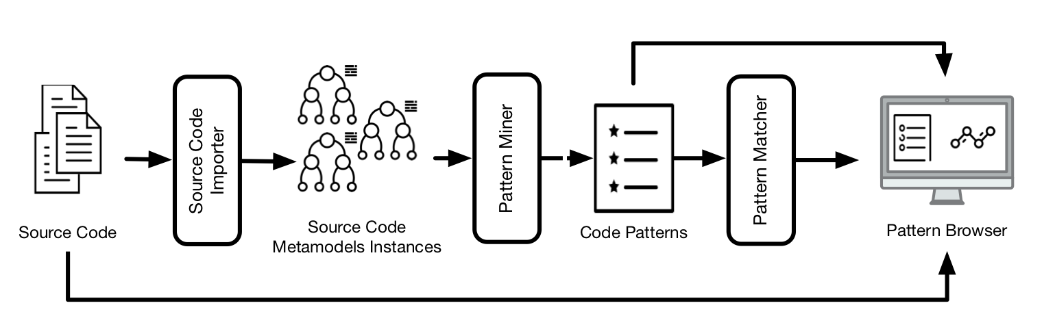
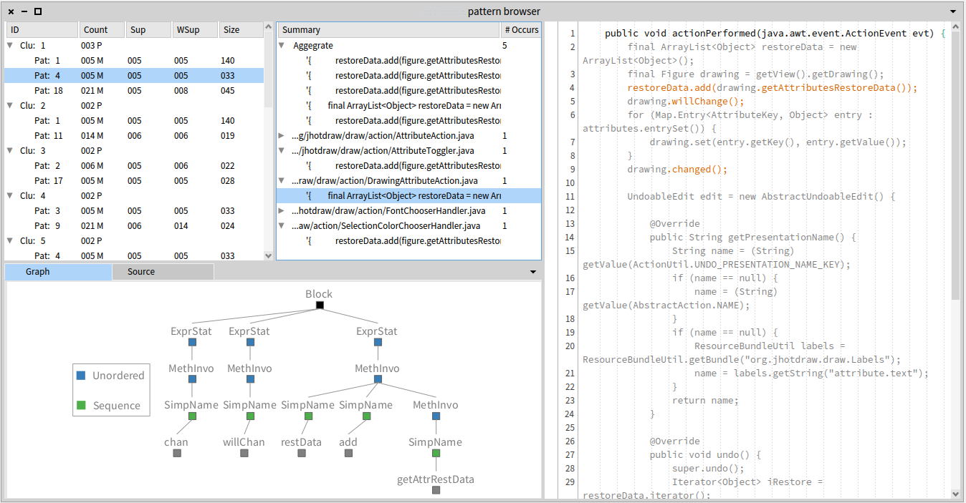
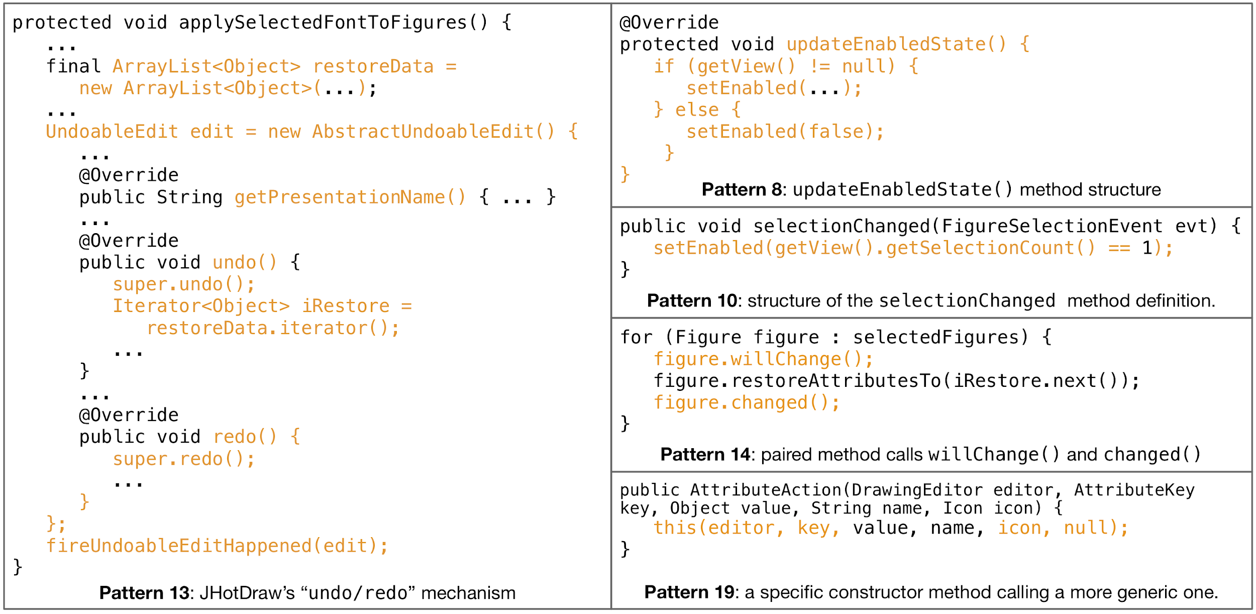
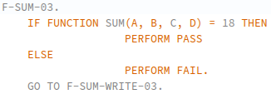
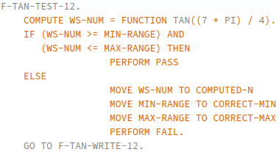
demo: mining for syntactic patterns
Cobol
JAVA
new FREQTals variant of the FREQT frequent subtree mining algorithm
  reduc ed mining time
  fewer patterns of little interest; many correspond to code regularities and some are large
specialized to scale on legacy systems
  parallelized, domain-specific constraints, match-based clustering to ease browsing
published at Discovery Science 2019, demonstrated at SATTOSE 2019 & <Programming 2019>

Slide 9
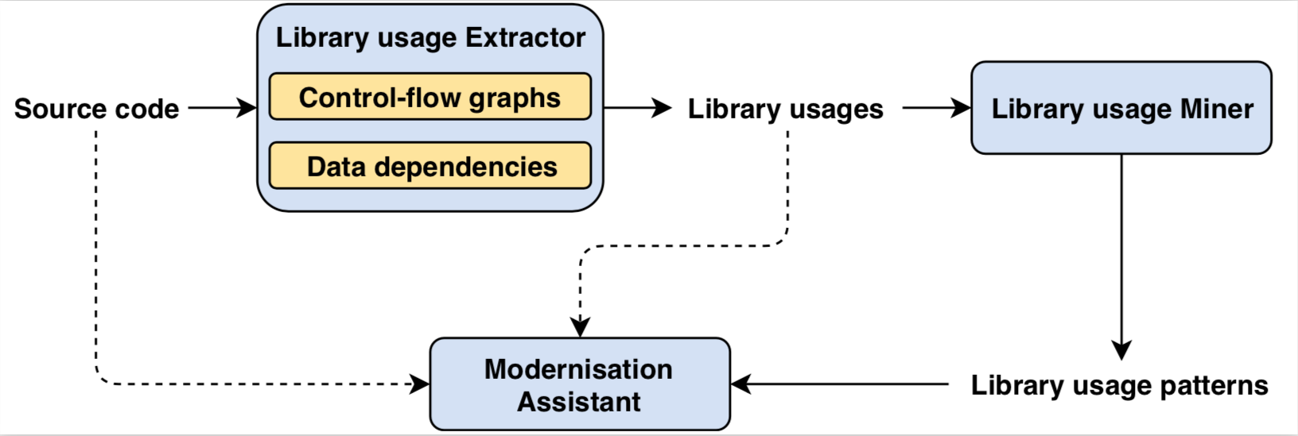
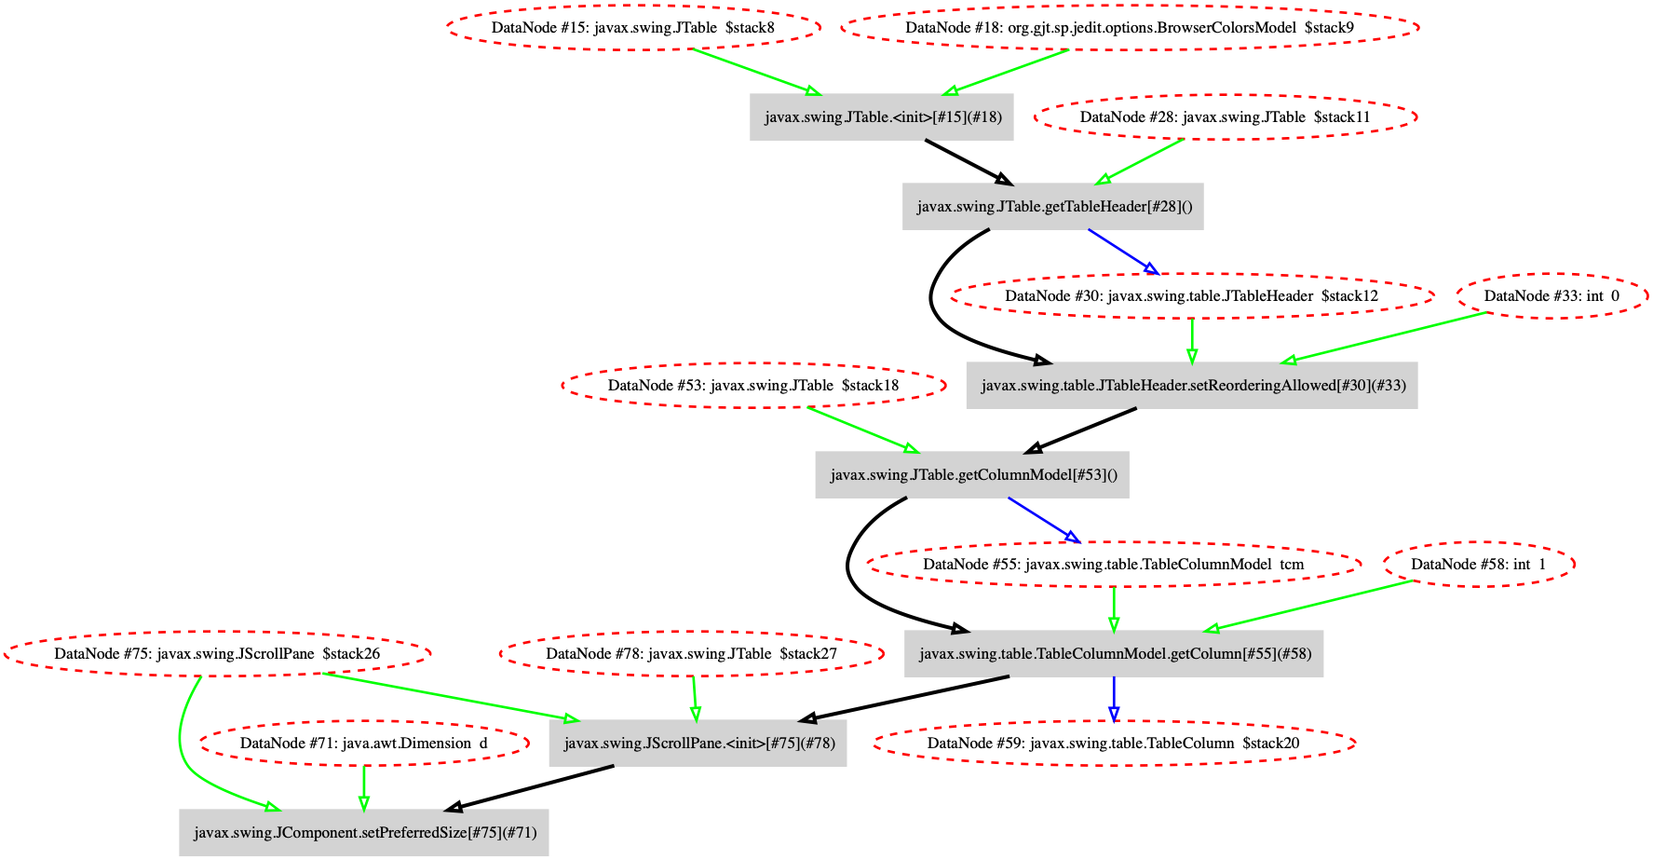
demo: mining for usage patterns
protected void _init() {
...
colorsModel = new BrowserColorsModel();
colorsTable = new JTable(colorsModel);
colorsTable.setAutoResizeMode(JTable.AUTO_RESIZE_ALL_COLUMNS);
colorsTable.getTableHeader().setReorderingAllowed(false);
colorsTable.addMouseListener(new MouseHandler());
colorsTable.getSelectionModel().addListSelectionListener(
new SelectionHandler());
TableColumnModel tcm = colorsTable.getColumnModel();
tcm.getColumn(1).setCellRenderer(new BrowserColorsModel.ColorRenderer());
Dimension d = colorsTable.getPreferredSize();
d.height = Math.min(d.height,200);
JScrollPane scroller = new JScrollPane(colorsTable);
scroller.setPreferredSize(d);
add(BorderLayout.CENTER,scroller);
...
}
language-agnostic XML representation of library usages
extract control- & data-flow information to generate library usage graphs from Java projects
extract control- & data-flow information from Cobol projects (graph generation in progress)
mine library usages for patterns using adaptation of BigGroum tool
  scales well to large amounts of code
Notes:
op de slide staat nu een voorbeeld waarin het gebruik van de Swing library is geanalyseerd
het pattern kan je kort beschrijven als “dit is wat je typisch zou doen om een tabel met een scrollbar aan je GUI applicatie toe te voegen

Slide 10
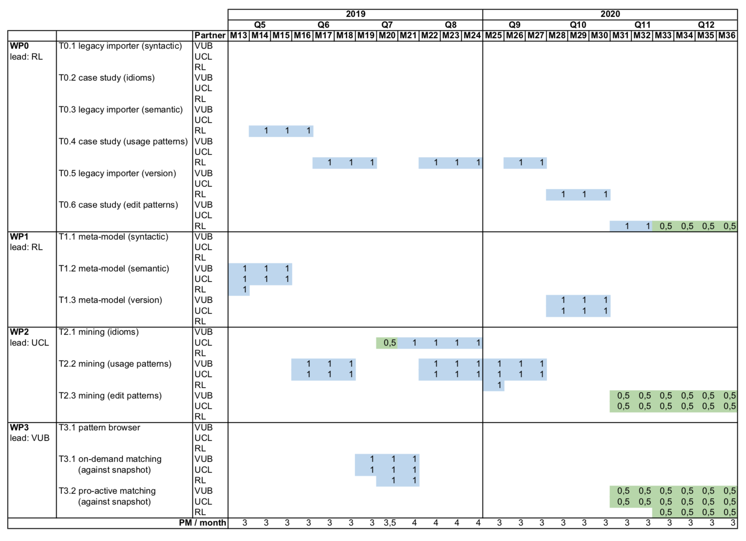
Anticipated changes
Changes for Y2
  Strengthen syntactic pattern miner developed in Y1 (and first months of Y2), based on a deeper evaluation of quality, quantity and relevance of found patterns
Changes for Y3
  Narrow focus to mining for edit patterns in contemporary C# code within RainCode products
  Use freed resources to strengthen usage pattern miner of Y2

Slide 11
Q&A

